Slide 1
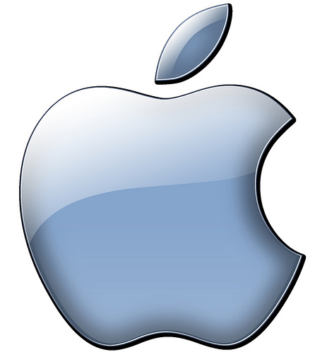


“Life Through Glass
An Apple, Microsoft, and Corning Story
Blaine Killen

Slide 2
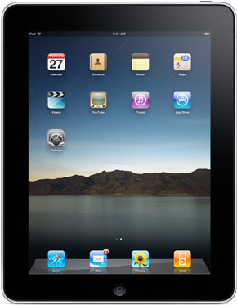
Why Touchscreen?
Intuitive
Bridge the age gap
Market is fairly new

Slide 3
Apple- 1976
“Bringing the best personal computing experience”
Ipad
Better personal touchscreen devices

Slide 4
Microsoft- 1975
“Help people and businesses realize full potential”
Microsoft Surface
Holo-phones, software, advertisements

Slide 5
Corning- 1851
“Deliver superior, long-range economic benefits”
Gorilla Glass
Mirrors, windows, tables

Slide 6
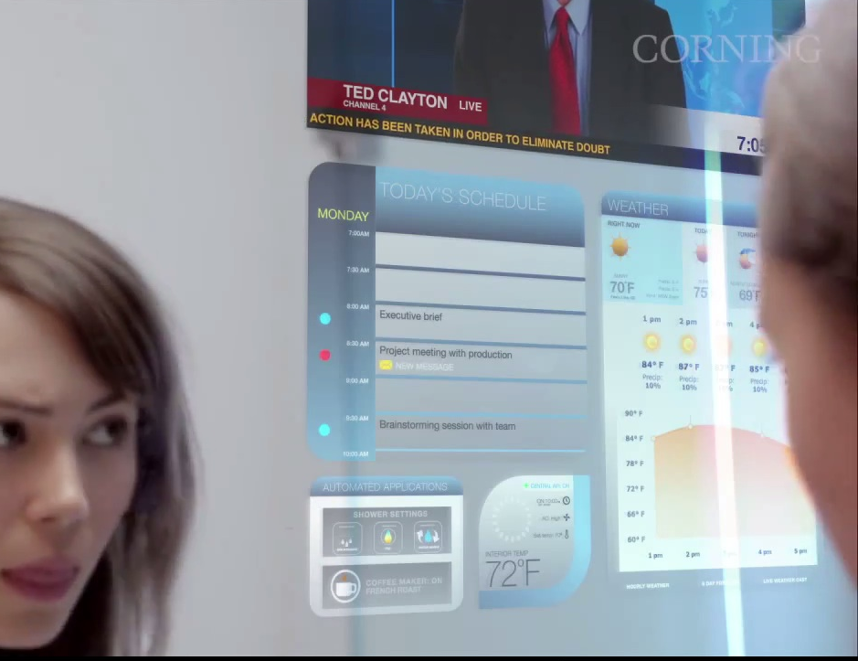
The Future Holds…
Life through glass
Everything’s touchscreen
Science-fiction comes true!!

Slide 7

What This Means?

Slide 8
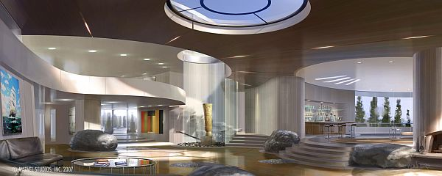

Slide 9
